Slide 1
Final Project 1
Michael Zeng
zengmiao2011@gmail.com

Slide 2
Potential Project 1: The Problem An Universal Model for NCAA Basketball Matchups
We are hoping to find a model that predicts the matchup between two NCAA Mens’ Division I basketball teams.
The model input will be team level stats
The model output will be odds of winning for the two teams (the team with winning odds higher than 50% is predicted to win the match up).
The training data set will be the data from all regular season games.
The testing data set will be the data from the tournament (play off).

Slide 3
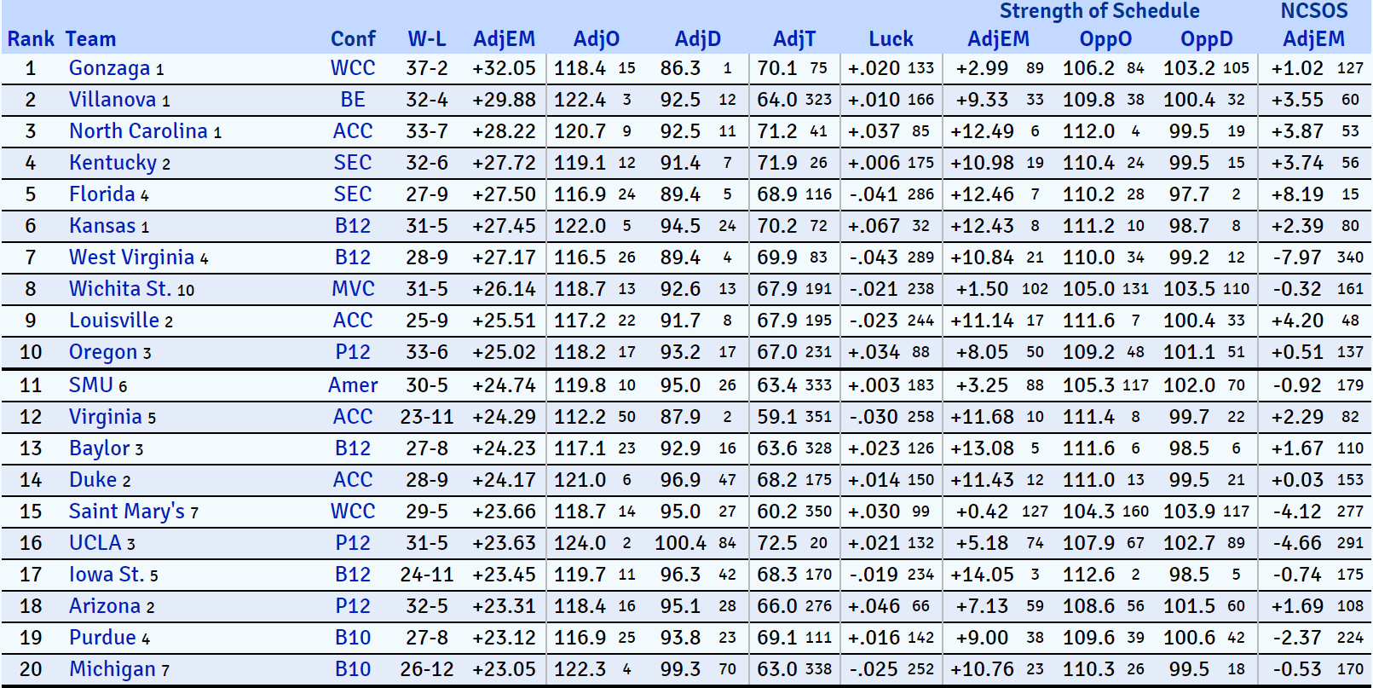
Potential Project 1: The Data An Universal Model for NCAA Basketball Matchups
From http://kenpom.com/, with an annual subscription of $19.95, I have access to:
Data ranging from 2002 to 2017
Detailed statistical breakdowns of every team and player in Division I.
Scores from all games

Slide 4
Potential Project 1: The Hypothesis An Universal Model for NCAA Basketball Matchups
We are expected to see a positive correlation between a team’s odds of winning in any matchup and the difference in defensive efficiency, offensive efficiency and ease of schedule of the two teams.

Slide 5
Potential Project 2: The Problem A Team Specific Model for UW Madison Men’s Basketball Team
Each team will have its own strength and weakness. The key to winning is not to have the higher average stats over all categories, but to play your strength and make the best of it.
By fitting the same model again, but for a specific team (UW-Madison Men’s Basketball Team, for example), we are hoping to see how the coefficients would be different from the universal model, as well as the predictive power shown in the training set.

Slide 6
Potential Project 2: The Data A Team Specific Model for UW Madison Men’s Basketball Team
From http://kenpom.com/, with an annual subscription of $19.95, I have access to:
Data ranging from 2002 to 2017
Detailed statistical breakdowns of every team and player in Division I.
Scores from all games

Slide 7
Potential Project 2: The Hypothesis A Team Specific Model for UW Madison Men’s Basketball Team
We are still expected to see the positive correlation remains between a team’s odds of winning in any matchup and the difference in defensive efficiency, offensive efficiency and ease of schedule of the two teams. However, the differences in model coefficients would tell us more about the style of the team and its unique strength in its game.

Slide 8
Potential Project 3: The Problem A Betting Scheme for March Madness Bracket
Every year once the NCAA Tournament bracket is published, people sets up their own brackets selecting winner in each matchup.
We hope to calculate our predicted matchup results and the bracket score as a result of it.
Compare the score to that of the official ranking.

Slide 9
Potential Project 3: The Data A Betting Scheme for March Madness Bracket
From http://kenpom.com/, with an annual subscription of $19.95, I have access to:
Data ranging from 2002 to 2017
Detailed statistical breakdowns of every team and player in Division I.
Scores from all games

Slide 10
Potential Project 3: The Hypothesis A Betting Scheme for March Madness Bracket
We are expected to see our model render a better score than that yielded by the official ranking.

